Slide 1
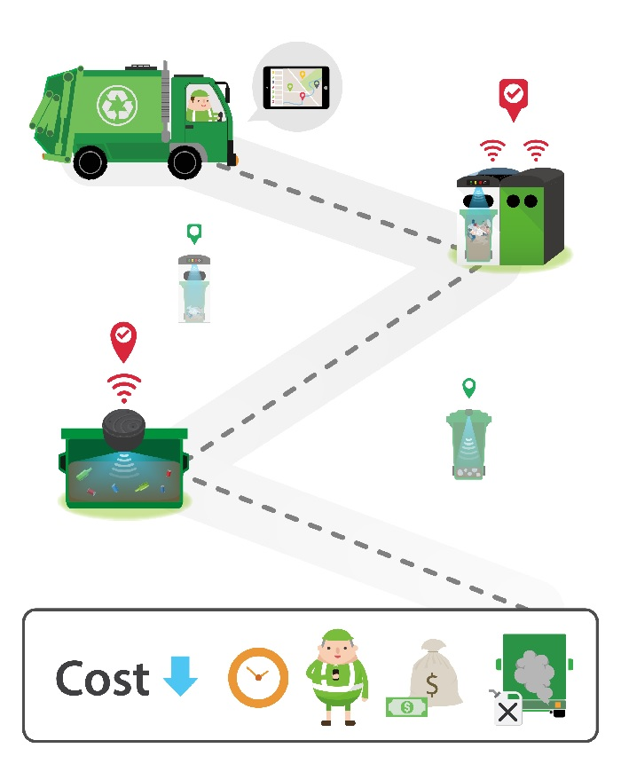
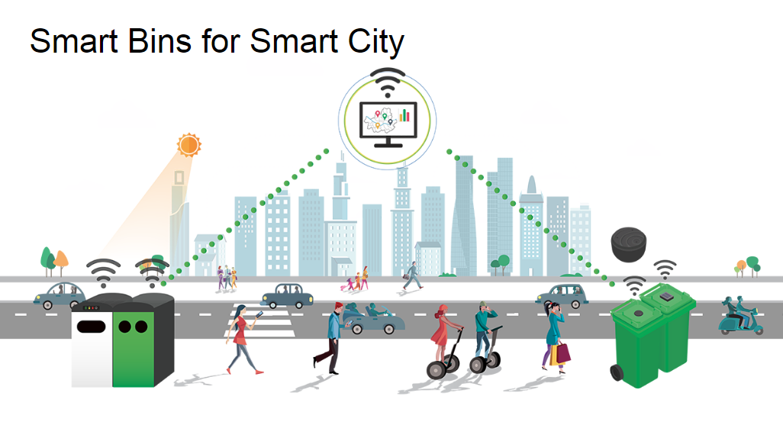
SMART TRASH COLLECTOR

Slide 2
INTRODUCTION
Waste Management is process of collection, transport, processing or disposal, managing and monitoring of waste materials. This term usually relates to materials produced by human activity, and process is generally undertaken for reduce their effect on health, the environment Waste management practices can differ for developed and developing nations, for urban and rural areas, and for residential and industrial producers. Managing of wastes properly is individual responsibility. Public awareness campaigns are necessary for environment protection. So need to encourage the people to be part of this objective, protecting our environment through proper waste management.

Slide 3
OBJECTIVE
This project aims to develop an automated trash bin that opens automatically when people come near it and send’s message to municipal commission when it is full once it gets filled

Slide 4
HARDWARE AND SOFTWARE REQUIREMENTS
Hardware requirement
Arduino Uno
Ultrasonic Sensors
LEDs
Servo Motor
GSM Module
Bread board

Slide 5
Software Requirements
OS -Windows
IDE- Arduino UNO IDE

Slide 6
WORKING
Current Product incorporates with weight sensor to find the level of the waste bin. So weight sensor is not applicable for products which are very light, very heavy and varies with size respectively. In IR sensor the weather can also interfere with reception from sunlight, rain, dust and the range of transmission is quite short compared to wired transmission then the speed at which the data is transmitted by infrared light is slower in order to avoid this problem. It also uses IR sensor to detect status of the waste bin but IR is not applicable to waste bin in darker areas [1].This process is proposed Ultrasonic sensor and GSM module. Ultrasonic sensor used to measure the object and GSM module is used to indicate the status of the dustbin but not share the location of the dustbin and GSM is need to send SMS every time. So it’s very expensive [2].For some applications to permanently wire nodes, many features such as waste bin monitoring require them to be wireless to allow bin status identification. As a result, low power consumption of the node and sensors should be minimal and managed in an inventive way so as to long battery lifetime. RFID-based node provides significant power saving since transmission only takes place at specified intervals and is of minimal Power[3].So Ultrasonic sensor are used. This sensor are used for identifying the level the dustbin and also the ultrasonic sensor is fixed at the top of trash, so sensor is prevented from water like wastes then make user friendly for waste collector to get the garbage. Sensors are fixed under the lid of the waste bins for compute the distance between the lid of the can and the garbage level, Using this data the trash level capacity calculated and message from the trash can, will be sent to the servers notifying them that the trash can is full.

Slide 7
WORKING PRINCIPLE
In our system, whole circuit is placed at top of the dustbin. In general, Ultrasonic sensors transmit head sent the trigger pulses continuously to the dustbin and echo pulse reflects back to ultrasonic sensor whenever there is object in front of the sensor. So, Ultrasonic sensor continuously checks the garbage level in dustbin. If the trash is not exceeding the limit as maximum, then cyclically checks the distance. Once the level of trash reaches particular threshold values, now the ultrasonic sensor gives indication to Arduino Uno and GPS searches the location where the dustbin is available, give the Latitudinal & Longitudinal details to the controller, then controller process these obtained data and send the intimation signal to the server through Wi-Fi along with the location details to waste collector. Trash level is measured by connecting access points to mobile or laptop’s by open the browser and enter corresponding IP address of Wi-Fi module. This server page is loaded with HTML language for viewing the sensor data remotely.

Slide 10
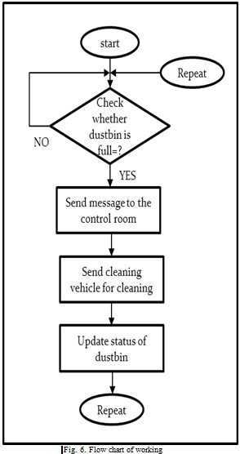
FLOW CHART

Slide 11
CONCLUSIONS
Advancements in latest technology in different sector of life and with the increasing population and changes in the lifestyle, waste management is another sector need to be maintained properly. So monitoring of the Trash bins with the use of sensors, it’s a possible way to monitor and clean the dustbin and more efficient system than the current existing. Our idea of “Embedded based Smart waste management system “mainly focuses on monitoring the waste management, providing a smart technology for waste management system, by this reducing human time and effort, cost and which results in healthy environment

